Slide 1

Large Scale Data Driven Applications
Introduction to MongoDB security

Slide 2
Outlines
By the end of this lecture, students should be able to:
Understand the key security challenges in MongoDB.
Learn the built-in security features of MongoDB.
Explore best practices for securing MongoDB deployments.
Recognize the importance of compliance and auditing in database security.

Slide 3
Why Database Security Matters
Modern applications generate and store vast amounts of sensitive data, including personal, financial, and business-critical information.
Databases are often targeted by attackers seeking to exploit vulnerabilities for data theft, corruption, or ransom.
Data breaches can result in:
Financial losses.
Reputational damage.
Legal penalties due to non-compliance (e.g., GDPR, HIPAA).
According to IBM¹, in 2024, the average cost of a data breach is $4.48 million globally.
a 10% increase over last year and the highest total ever.
¹ https://www.ibm.com/reports/data-breach
Notes:
HIPAA stands for the Health Insurance Portability and Accountability Act of 1996. HIPAA's purpose is to protect the privacy, security, and integrity of protected health information (PHI) in United States.

Slide 4
Examples of Database Security Incidents
MongoDB Ransomware Attacks: Open, unsecured MongoDB instances exposed to the internet have been targeted by attackers demanding ransom for data.
Notable Cases:
In 2017, over 27,000 MongoDB databases were wiped in a ransomware campaign.
Companies faced permanent data loss and paid ransoms due to insufficient backups.
Broader Implications: Insecure configurations or poor security measures can lead to devastating consequences.

Slide 5
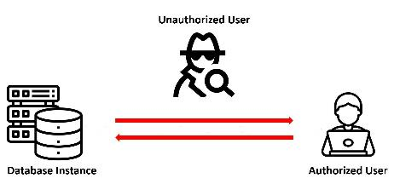
Security Challenges in Modern Databases
Default Configurations: Many database systems, including MongoDB, historically ship with permissive default settings.
Open Database Ports: Exposing database ports (e.g., 27017 for MongoDB) to the internet without securing them invites attackers.
Weak Authentication: Databases running without authentication or using default passwords are easy targets.
Lack of Encryption: Data transmitted over networks or stored on disks without encryption can be intercepted or accessed.
https://vertabelo.com/blog/database-design-for-security/

Slide 6
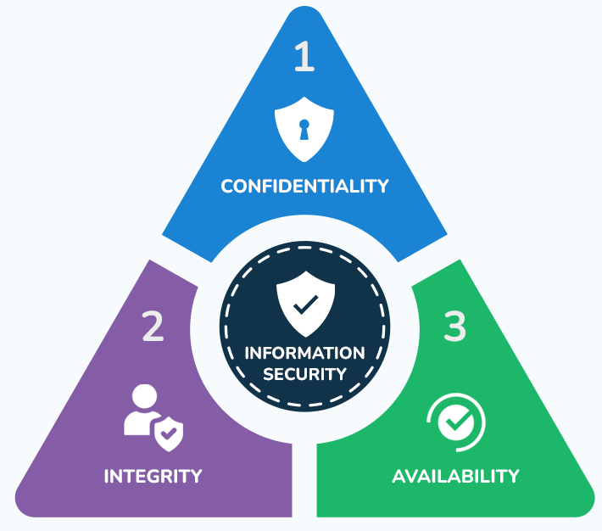
Goals of Database Security
Confidentiality: Ensure only authorized users can access sensitive data.
Integrity: Prevent unauthorized modification of data.
Availability: Protect data and ensure it is accessible when needed.
Compliance: Meet legal and regulatory requirements (e.g., GDPR).
https://www.stationx.net/what-is-the-cia-triad/

Slide 7
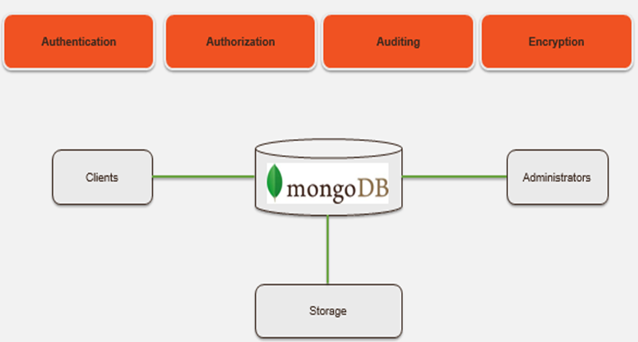
Introduction to MongoDB Security Layers
MongoDB’s security is built on four critical layers:
Authentication: Verifies user identities.
Authorisation: Controls access to data and operations.
Auditing: Tracks and logs database activity.
Encryption: Protects data at rest and in transit.
Each layer ensures confidentiality, integrity, and accountability

Slide 8
MongoDB: Authentication
Authentication is the process of verifying the identity of users or systems attempting to access the MongoDB database.
It ensures that only authorised individuals or applications can interact with the database.
Authentication Mechanisms in MongoDB: MongoDB supports several authentication mechanisms depending on the deployment and security requirements
SCRAM (Salted Challenge Response Authentication Mechanism)
MongoDB-CR (Challenge-Response)

Slide 9
Authentication: SCRAM
SCRAM is MongoDB’s default authentication mechanism (starting with version 3.0).
Available as SCRAM-SHA-1 and the more secure SCRAM-SHA-256 (introduced in MongoDB 4.0).
Relies on password hashing and a challenge-response protocol to authenticate users.
How It Works:
User passwords are never stored in plaintext; instead, hashed values are stored.
During authentication:
The client sends a username and a hashed password.
The server verifies the hash using a stored hash and a salt.
Why Use SCRAM?
Provides a secure and robust password-based authentication mechanism.
Supports role-based access control (RBAC) and integrates well with MongoDB's architecture.

Slide 10
Authentication: MongoDB-CR
An older mechanism used in pre-3.0 versions of MongoDB.
Replaced by SCRAM due to security vulnerabilities.
How It Works:
Involves a simple challenge-response protocol where the server sends a challenge string, and the client responds with a hashed password.
Why Use Avoid MongoDB-CR?
Considered less secure compared to SCRAM.
Deprecated and not recommended for modern deployments.

Slide 11
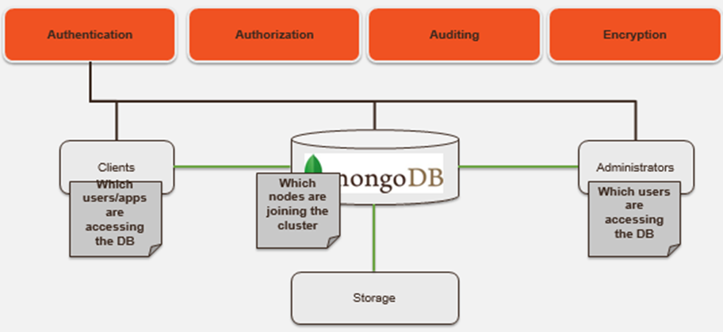
MongoDB: External Authentication Methods
MongoDB integrates with external systems for centralised authentication:
LDAP (Lightweight Directory Access Protocol):
Enables organisations to authenticate users via an existing LDAP server.
Useful for large organisations where user credentials are managed centrally.
Example: Authenticating corporate users against an Active Directory (AD).
Kerberos:
A secure authentication protocol using tickets.
Ideal for enterprise environments requiring strong security measures.

Slide 12
How to Enable Authentication in MongoDB
Enable Authentication: Add the --auth flag when starting the MongoDB server.
mongod --auth --dbpath /data/db
The db.auth() method in MongoDB is used to authenticate a user against the database.
It ensures that only authorized users can access or perform operations on the database.
db.auth({
user: <name>, // Required: The username to authenticate.
pwd: "<cleartext password>", // Required: The user's password in plaintext.
mechanism: <auth. mechanism>, // Optional: The authentication mechanism to use.
digestPassword: <boolean> // Optional: Indicates whether the password is hashed.
});
https://docs.mongodb.com/manual/reference/method/js-user-management/

Slide 13
MongoDB authentication best practices
Enable access control and use one of MongoDB's authentication methods mentioned before.
Always use SCRAM-SHA-256 for stronger password protection.
Start by creating an administrator user. Then add additional users as needed.
Encrypt all communications between mongod and mongos instances as well as internal and external communications using TLS/SSL.
Encrypt data on each MongoDB host using filesystem, device, or physical encryption.
Run MongoDB on a trusted network only. Do not allow your database to be run to the public internet.
Regularly audit user accounts and update passwords.

Slide 14
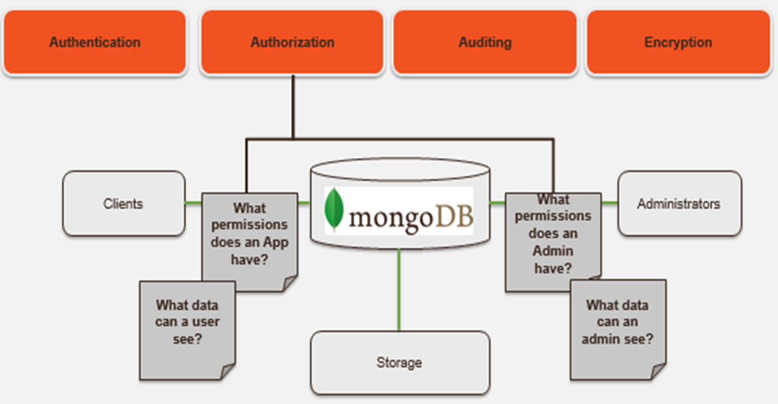
MongoDB: Authorisation(Role-Based Access Control)
Once MongoDB has established “who” you are, authorisation is about determining “what” you are allowed to do.
The purpose is to limit what authenticated users can do within the database.

Slide 15
MongoDB: Authorisation(Role-Based Access Control)
MongoDB uses RBAC to assign specific roles to users.
Database Level Access Control
Admin roles – DB, user, cluster
Application roles – reader, reader/writer
Collection Level Access Control
User defined roles
Privileges granted to roles for actions on resources
Database, collection and system resource types
Field Level Access Control
Redact documents and/or fields based on security labels

Slide 16
MongoDB: Authorisation(Role-Based Access Control)
MongoDB uses RBAC to assign specific roles to users.
Common Predefined Roles
read
readWrite
dbAdmin
userAdmin
readAnyDatabase
readWriteAnyDatabase
dbAdminAnyDatabase
userAdminAnyDatabase
clusterAdmin
db.createUser({
user: "developer",
pwd: "devpass",
roles: [{ role: "readWrite", db: "projectDB" }]
});
The roles that are bold can only be granted in the admin database.

Slide 17
Guideline for Authorisation/role-based security
To ensure privileges are never misused, consider following these guidelines:
Understand each role right down to its most minute detail. The better roles are understood, the more accurately privileges can be assigned to them.
It's best to follow a principle of least privilege. Assign to users only those roles they need to get the job done. More privileges can be assigned if needed.
Create a resource to help users understand basic information security. To let staff understand the security requirements and are clear on what consequences they can face should the requirements not be met.
Revoke access of users no longer with your organisation as soon as they leave.

Slide 18
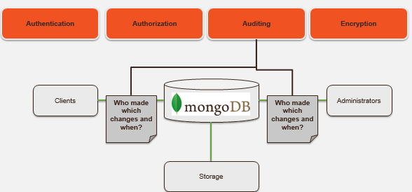
MongoDB: Auditing
The auditing facility allows administrators and users to track system activity for deployments with multiple users and applications.
The purpose is to track and log database operations for accountability and compliance.

Slide 19
Enable and Configure Audit Output
The auditing facility can write audit events to the console, the syslog, a JSON file, or a BSON file.
Modify the Configuration File (mongod.conf): Audit logging is configured in the mongod.conf file. Below is an example configuration:
auditLog:
destination: "file" # Output destination for audit logs (options: file, console, or syslog).
format: "JSON" # Format of the audit log (options: JSON or BSON).
path: "/var/log/mongodb/audit.log" # File path for audit log storage (used if destination is "file").
filter: '{ atype: { $in: ["authenticate", "update", "delete"] } }' # Filter for events to log.
{
"atype": "authenticate",
"ts": {"$date": "2024-11-11T12:00:00Z"},
"local": {"ip": "127.0.0.1", "port": 27017},
"remote": {"ip": "192.168.1.100", "port": 61000},
"users": [{"user": "admin", "db": "admin"}],
"result": 0
}
Sample JSON Output for Authentication
Notes:
atype: The action type (e.g., authentication attempt).ts: Timestamp of the event.local: The server's IP and port.remote: The client’s IP and port.users: The user involved in the event.result: Authentication result (0 for success, non-zero for failure).

Slide 20
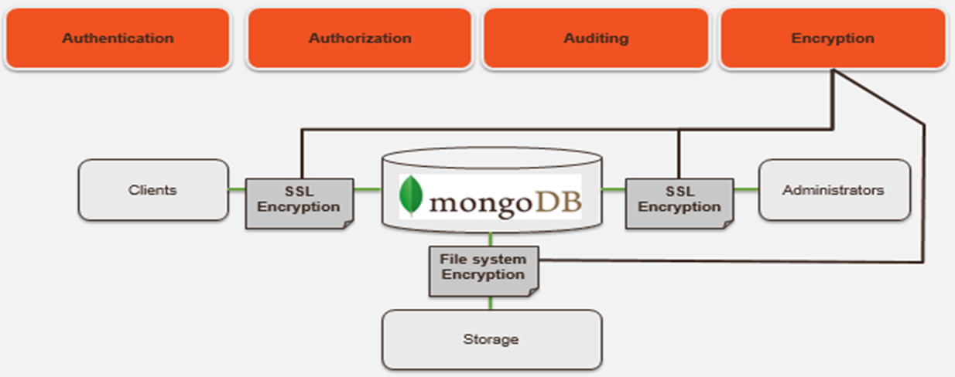
MongoDB: Encryption
Encryption ensures that data is protected from unauthorised access, even if intercepted or stolen.
Protects sensitive information during communication (in transit).
Secures data at rest, ensuring compliance with regulations like GDPR, HIPAA, and PCI-DSS.
Without encryption:
Data transmitted over the network can be intercepted (man-in-the-middle attacks).
Stolen database files can expose sensitive information.
Notes:
Payment Card Industry Data Security Standard (PCI-DSS)

Slide 21
Types of Encryption in MongoDB
Encryption in Transit:
Ensures that data sent between clients, servers, and replica set members is encrypted using TLS/SSL (Transport Layer Security/Secure Sockets Layer).
TLS/SSL ensures that MongoDB network traffic is only readable by the intended client.
Protects against interception during communication.
Encryption at Rest:
Encrypts data stored on disk, preventing unauthorized access to database files.
Available in MongoDB Enterprise Edition and MongoDB Atlas.
Notes:
Payment Card Industry Data Security Standard (PCI-DSS)

Slide 22
Configuring Encryption in Transit
Enable TLS/SSL:
Start the mongod process with the --sslMode option:
mongod --sslMode requireSSL --sslPEMKeyFile /path/to/certificate.pem
--sslPEMKeyFile: Path to the Privacy Enhanced Mail (PEM) file containing the server's certificate and private key.
Optional:--sslCAFile: Path to the Certificate Authority (CA) file for client certificate validation.
Verify Connection: Use the mongo shell to connect with --ssl:
mongo --ssl --host <hostname> --port <port> --sslCAFile /path/to/ca.pem

Slide 23
Configuring Encryption at Rest
Available in MongoDB Enterprise Edition.
Supports AES-256 encryption.
Specify encryption options in the mongod.conf file:
security:
enableEncryption: true
encryptionKeyFile: /path/to/keyfile
encryptionKeyFile: File containing the encryption key.
Supports integration with Key Management Systems (KMS) like AWS KMS, Azure Key Vault, and Google Cloud KMS for secure key storage.

Slide 24
Best Practices for Encryption
Use TLS/SSL for all communications between clients, servers, and replicas.
Enable encryption at rest for sensitive or regulated data.
Rotate encryption keys periodically and store them securely (preferably in a KMS).
Regularly test encryption configurations to ensure they are working correctly.
Monitor encrypted environments to detect misconfigurations or breaches.

Slide 25
Best Practices for MongoDB Security
Always enable authentication and use strong passwords.
Restrict access to the database server using firewalls and IP whitelisting.
IP whitelisting: Restricting database access to specific IP addresses.
Use encryption for data in transit and at rest.
Regularly update MongoDB to the latest version to patch vulnerabilities.
Audit and monitor database activity to detect suspicious behaviour.
Avoid using root roles for regular tasks; follow the principle of least privilege.

Slide 26
Scenario: Using MongoDB for an IoT-Based Smart Healthcare Application
Imagine a smart healthcare application that uses IoT devices (such as wearable fitness trackers, smart insulin pumps, and connected heart monitors) to continuously monitor patients’ health. Data from these IoT devices is collected, stored, and analysed in real-time using MongoDB as the backend database.
The application provides critical features:
Real-Time Monitoring: Tracks vital signs like heart rate, blood sugar levels, and blood pressure.
Alerts and Notifications: Sends alerts to doctors and family members in case of abnormal readings.
Health History and Analytics: Stores and analyses historical data to generate insights and predictions for personalized healthcare.
What potential security concerns can you identify for this application?

Slide 27
Thoughts on Potential Security Concerns
Unencrypted Communication: Real-time data from IoT devices is transmitted to MongoDB without TLS encryption, making it vulnerable to interception.
Open Database Ports: The MongoDB instance is exposed to the internet with no firewall or IP restrictions, making it susceptible to unauthorized access.
Insufficient Authentication: Database authentication is disabled, allowing anyone with the IP address to access patient data.
Weak Authorisation Rules: A junior developer was given admin-level access for convenience, violating the principle of least privilege.
Audit Logs Missing: No audit logging is configured, leaving no record of who accessed the database or what operations were performed.
At-Rest Data Exposure: The database does not use encryption at rest, making the data vulnerable if someone gains access to the physical server or storage.

Slide 28
Questions?

